Slide 1
ORIGINAL PLANNING FOR U.S. MILITARY GOVERNMENT IN TAIWAN

Slide 2
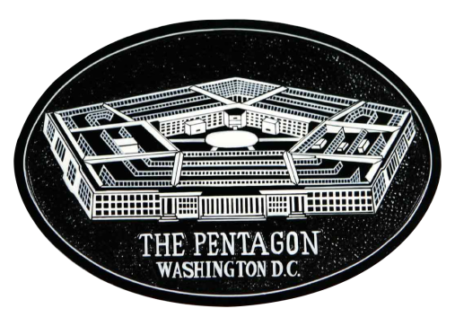
excerpts from PAPERS CONCERNING MILITARY GOVERNMENT IN FORMOSA

Slide 3
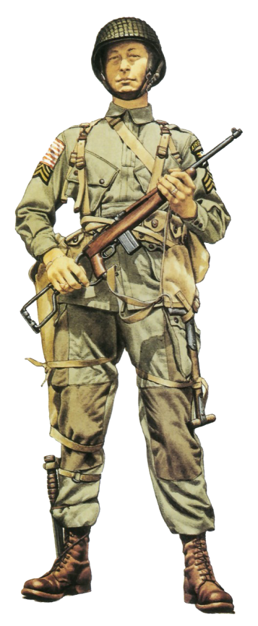
excerpts from PAPERS CONCERNING MILITARY GOVERNMENT IN FORMOSA
The Inter-Divisional Area Committee on the Far East has prepared fourteen papers on military government in Formosa to answer twenty-eight questions submitted to the Department by the Civil Affairs Division of the Army and the Occupied Area Section of the Navy. These answers are based on the conditions which it is believed will probably exist in Formosa during the period of military government. It is realized that new conditions may arise which will cause the Department to revise these papers or to issue new suggestions as to political aspects of military government in Formosa.

Slide 4
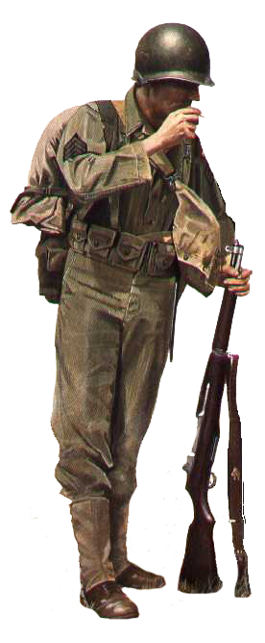
Washington, D.C. June 28, 1944
The main points of the papers which contain recommendations as to policy, as distinct from details of administration, are as follows:

Slide 5
1. Transfer of Formosa to China
It is recommended that the planning for military government in Formosa proceed on the assumption that Formosa and the Pescadores will be returned to China without reservations, that is, without any condition that China shall grant rights for bases on Formosa. It is envisaged that American military administration of civil affairs in Formosa will continue until such time as Chinese sovereignty in Formosa is restored.

Slide 6
2. Military Government
It is assumed that a military government will be established in Formosa by the United States. It is recommended that, even if the Japanese Government should capitulate before a forcible occupation of Formosa becomes necessary, the United States forces should, nevertheless, occupy the island, and establish a military government. The military authorities will retain sole responsibility and authority for civil affairs administration.

Slide 7
3. Chinese Participation
It is recommended that Chinese participation should be sought in both the planning and administration of civil affairs in Formosa. This participation, however, should not in any way restrict the exclusive authority of the American military government. It the occupation of Formosa should be aided by Chinese forces operating from the mainland; if feasible there should be provision for Chinese representation on the civil affairs staff.

Slide 8
In the administration of Formosa, Chinese-Formosans should be used as fully as possible; American citizens and Filipinos of Chinese race should be employed on the same basis as other Americans; Chinese citizens, residing in China or in the United State, should be employed only with the approval of the Chinese National Government. All persons employed by the Civil Affairs Administration should be subject to the direct order of the American military government. As a general rule, short-term administrative acts of the military government in Formosa should be designed to meet the immediate needs of Formosan interests as distinct from interests of the Chinese National Government; and administrative acts designed for operation over a comparatively long term, such as acts in respect to the educational system, should accord with Chinese Government policies in so far as those policies are consistent with American ideals and international law.

Slide 9
4. Treatment of the Inhabitants of Formosa and the Japanese Mandated Islands
A. Japanese residents
The military government, in its treatment of Japanese civilians in Formosa and the Japanese Mandated Islands (1) should be guided by international law, (2) should undertake no mass segregation, internment or removal not required by military necessity, and (3) should not attempt to anticipate a decision as to the disposition of Japanese civilians after the war.
B. Non-Japanese Inhabitants of Formosa
Although Chinese-Formosans and the aborigines, in a legal sense, are enemy nationals, in a political sense, the Chinese-Formosans should be treated as "liberated peoples", and the tribal aborigines as wards of the military government.

Slide 10
5. Treatment of Japanese Property
The military authorities in their treatment of Japanese property in Formosa, both Government and private, should apply the Rules of Land Warfare of the Hague Convention of 1907. Private Japanese interests should be respected. The military government should assume stewardship of all Japanese Government properties pending final settlement. It is recommended that in principle the Japanese Imperial Household properties be treated as though they were Japanese Government property.

Slide 11
6. Laws under the Military Government
Laws in force in Formosa at the time of military occupation should be regarded as continuing except as superseded by proclamation having the force of law issued under the authority of the military government. As to existing ordinary civil and criminal law, no attempt should be made to substitute Chinese law. With existing land-ownership rights and tenancy contracts the military government should interfere as little as possible.

Slide 12
Source: United States Department of State / Foreign relations of the United States diplomatic papers, 1944. The Near East, South Asia, and Africa, the Far East (1944) Volume V: Japan, pp. 1266-1269
Online Reference:
University of Wisconsin Digital Collections
Foreign Relations of the United States
The Near East, South Asia, and Africa, the Far East (1944)
Volume V: Japan, pp. 1266-1269
Internet -- http://goo.gl/8vvMNB

Slide 13
Commentary

Slide 14
Commentary by Taiwan Studies Group
The above guidelines were approved by the U.S. Executive Branch for U.S. military government in Taiwan, and promulgated some fourteen months before the Japanese surrender in Taiwan in late October 1945. However, frankly speaking, these guidelines were not followed.
We are currently in the 21st century. Let’s look again at the situation of Taiwan during WWII in the Pacific, and try to formulate what remedial actions would be appropriate for preserving and enhancing the human rights of native Taiwanese people in the present era. We can present these in the form of “Recitals.”

Slide 15
WHEREAS
In the famous American Insurance Company case, 26 U.S. 511 (1828), Chief Justice Marshall offered this penetrating analysis:
The Constitution confers absolutely on the government of the Union the powers of making war and of making treaties; consequently, that government possesses the power of acquiring territory, either by conquest or by treaty.
And more explicitly, in United States v. Huckabee, 83 U.S. 414 (1872), the Court speaking through Mr. Justice Clifford, said:
Power to acquire territory either by conquest or treaty is vested by the Constitution in the United States. Conquered territory, however, is usually held as a mere military occupation until the fate of the nation from which it is conquered is determined . . . .

Slide 16
During the course of the Pacific War, the historical record shows that United States military forces (air force, naval, etc.) liberated the Japanese islands of Formosa & the Pescadores. The United States is the "conqueror."
The conqueror has the belligerent right to institute military government over conquered territory. A dictionary definition says that "military government" is the form of administration by which an occupying power exercises government authority over occupied territory.
With the close of the Pacific War, the Allies have disbanded. Taiwan remains as territory conquered by U.S. military forces which did not achieve a final political status in the post-war peace treaty. Significantly, Taiwan’s final legal status has remained undetermined up to the present day.

Slide 17
WHEREAS
After being transported to Taiwan on U.S. ships and aircraft, the military forces under Chiang Kai-shek (CKS) accepted the Japanese surrender on behalf of the Allies, according to the specifications of General Order No. 1, issued by Douglas MacArthur. However, surrender ceremonies and the ensuing military occupation of Taiwan are two different things. The military occupation is being conducted on behalf of the "conqueror" and the "principal occupying power" -- the United States.
Military occupation is conducted under "military government," and the United States has effectively delegated the military occupation of Taiwan to Chiang Kai-shek, head of the ROC, by means of the "law of agency." Military occupation is period of "interim (political) status.“

Slide 18
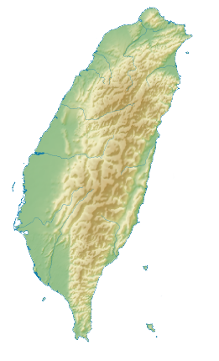
The law of agency is the body of legal rules and norms concerned with any principal – agent relationship, in which one person (or group) has legal authority to act for another. The law of agency is based on the Latin maxim "Qui facit per alium, facit per se," which means "he who acts through another is deemed in law to do it himself."

Slide 19
WHEREAS
In the San Francisco Peace Treaty of April 28, 1952, Japan renounced all right, title and claim over Taiwan without designating a "receiving country." However, Article 23(a) of the treaty designates the United States as the principal occupying power, and Article 4(b) confirms USMG jurisdiction over Taiwan.
The Allies did not recognize any transfer of Taiwan’s territorial sovereignty to “China” upon the Oct. 25, 1945 date of the Japanese surrender ceremonies in Taiwan, nor on any other date in the 1940s, 1950s, 1960s, 1970s, etc.
With reference to the One China Policy and the provisions of the Taiwan Relations Act, the nomenclature of “Republic of China” is not recognized after Jan. 1, 1979.

Slide 20
The following actions by the Republic of China authorities are serious violations of the laws of war and should be annulled by USMG proclamation:
the announcement of "Taiwan Retrocession Day" on Oct. 25, 1945,
the announced mass naturalization of Taiwanese persons as ROC citizens in Jan. 1946,
the implementation of the ROC Constitution in Taiwan beginning in late 1947, etc.
Additional violations could also be listed.

Slide 21
WHEREAS
The U.S. State Dept. informed the Senate in 1970 that "As Taiwan and the Pescadores are not covered by any existing international disposition; sovereignty over the area is an unsettled question subject to future international resolution." This statement has been often repeated since, however it must be qualified by noting that USMG administrative authority over Taiwan was specified in the SFPT. Hence, the treaty effectively placed Taiwan under de jure U.S. military occupation, which is described in military terms as a "Civil Affairs Administration of a military government."

Slide 22
The U.S. Supreme Court has ruled that for a territorial cession after war, the military government of the (principal) occupying power does not end with the coming into force of the peace treaty, but continues until legally supplanted by a recognized “civil government” for the territory. See Dooley v. U.S., 182 U.S. 222 (1901); DeLima v. Bidwell, 182 U.S. 1 (1901); Cross v. Harrison, 57 U.S. 164 (1853); etc.
A thorough examination of the legal record from the administration of President Truman to the present fails to reveal any record of the announcement of the end of USMG jurisdiction over Taiwan. Hence, Taiwanese efforts at obtaining “autonomy” and working toward eventual "self-determination" should begin with the recognition that USMG jurisdiction over Taiwan is still active. Taiwan is not independent at the present time.

Slide 23
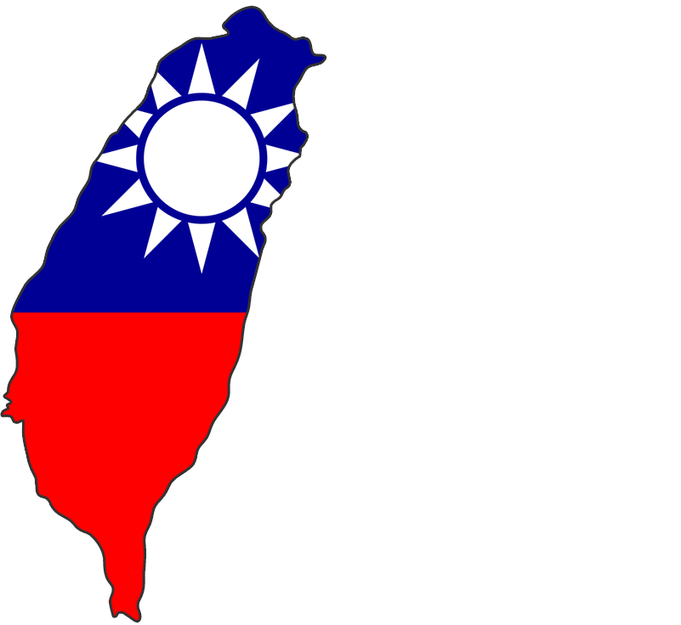
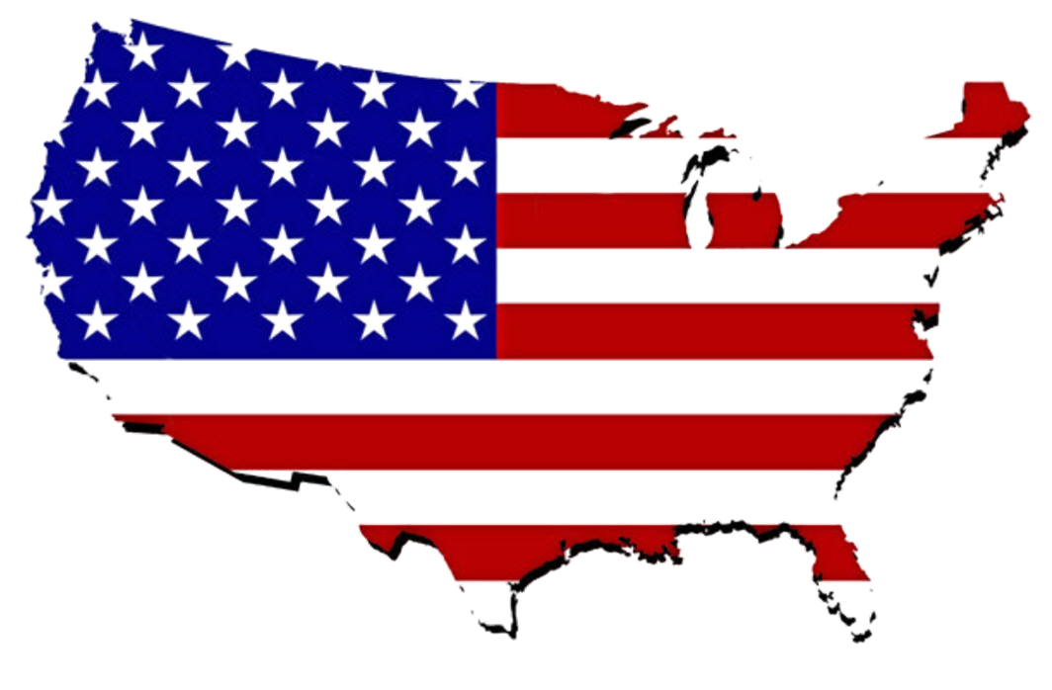
In late October 1949, Chinese President Li Zongren stated that he would prefer a joint Sino-American Commission govern Taiwan, but if the U.S. did not favor this proposal, the U.S. could properly take over Taiwan by "right of conquest."

Slide 24
THEREFORE, PREMISES CONSIDERED
Based on the above, the U.S. Dept. of Defense should immediately cancel all delegation of authority to the Chinese Nationalists for the administration of Taiwan, and assist the native Taiwanese people in discarding the legacy of the Republic of China, which is without any international legitimacy to govern Taiwan.
Direct USMG jurisdiction should be initiated, according to the “common defense” clause of the U.S. Constitution and the specifications of the SFPT.

Slide 25
Now, therefore, be it RESOLVED
That the U.S. Executive and Congressional branches should offer all necessary aid and assistance to the native Taiwanese people for proper reorganization of Taiwan’s governance system. A U.S. military governor should be appointed for Taiwan, and should immediately announce procedures for selecting delegates for a constitutional convention to draft a new Taiwan Constitution, and under the authority thereof to design a new Taiwan flag, conduct new Taiwan elections, reformulate Taiwan educational policy, tax policy, cultural policy, health & medical policy, fuel & energy policy, news media & broadcasting policy, agricultural & fishery cultivation policy, water resource control policy, police governance policy, etc.

Slide 26
Such arrangements are authorized by the historical precedent established in dealing with conquered island territory in the Spanish American War. In particular, the situation of occupied Cuba in the 1899 to 1902 period, and before the recognition of Cuba's independence, has many important points of comparison.
As a "government in exile," the Republic of China may be allocated a small portion of land in Taiwan to continue to conduct its own affairs, until such time as it can completely remove itself back to mainland China.
In this way, the native Taiwanese people will attain a high degree of self governance and autonomy as the westernmost insular area of the United States of America.

Slide 27
Thank you for your attention.
Taiwan Studies Group
2014 – 2015
version 1.0

